Slide 1
JFreeChart
Scatter Plot
David Gamaliel Arcos Bravo

Slide 2
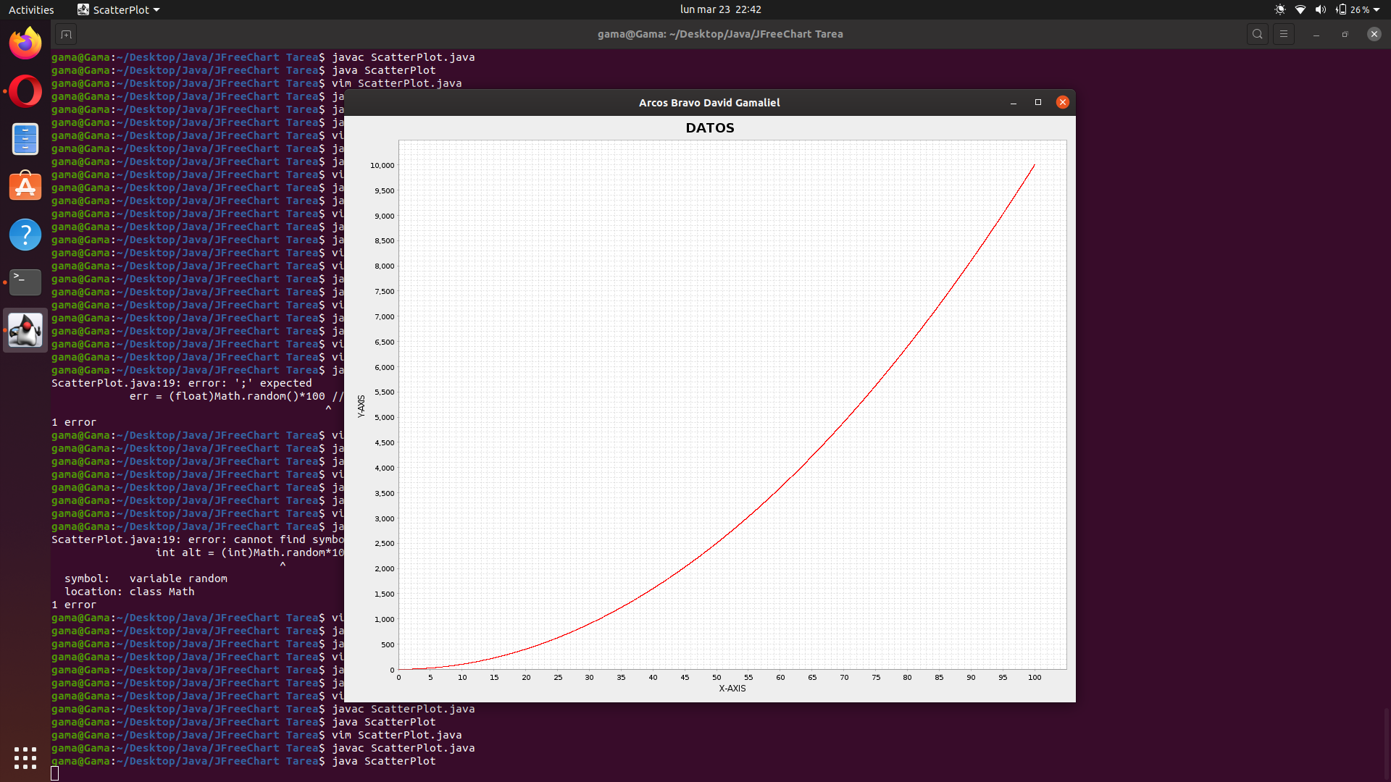

Slide 3
FastScatterPlot
CONSTRUCTORES
FastScatterPlot()
FastScatterPlot(
float[][] data,
ValueAxis domainAxis,
ValueAxis rangeAxis
)
MÉTODOS PRINCIPALES
void setData(float[][] data)
float[][] getData()
void setDomainAxis(ValueAxis axis)
void setRangeAxis(ValueAxis axis)

Slide 4
Link de descarga
https://repo1.maven.org/maven2/org/jfree/jfreechart/1.5.0/

Slide 5
Link de documentacion
http://www.jfree.org/jfreechart/api.html

